Slide 1
How to install an app on ubuntu?

Slide 2
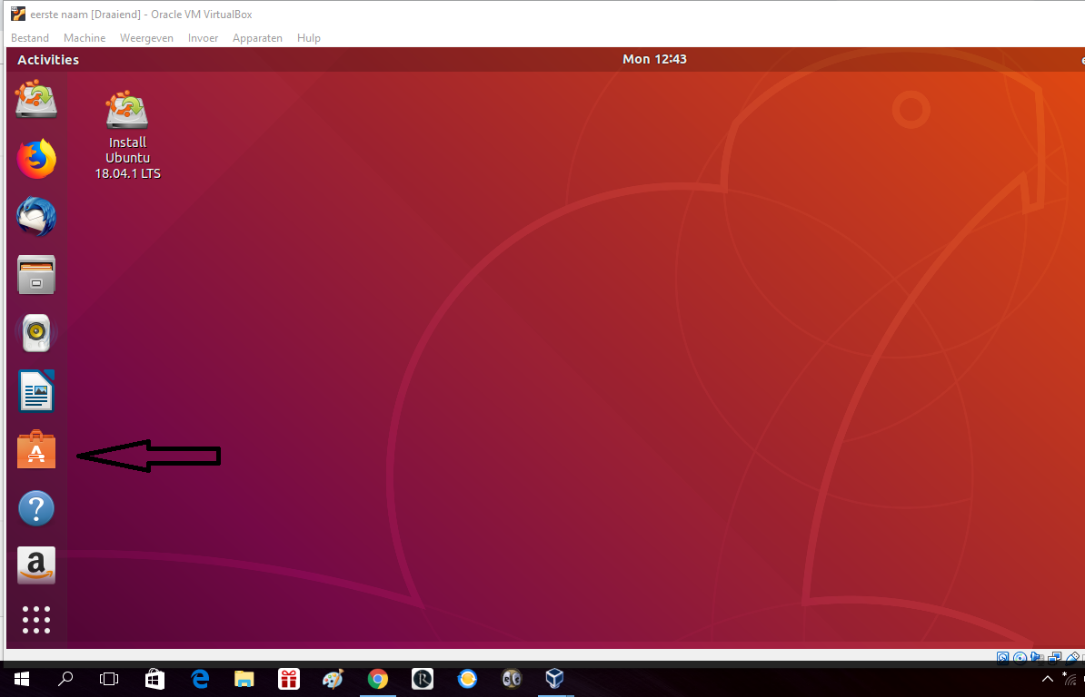
Klick on the ubuntu software

Slide 3
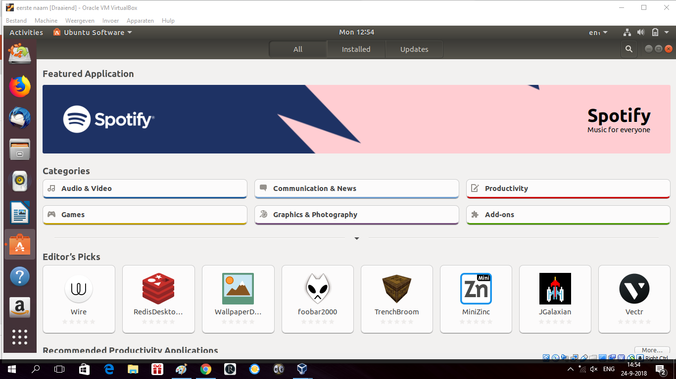
Either search at the loop or press any catagory

Slide 4
Klick on the app you want

Slide 5
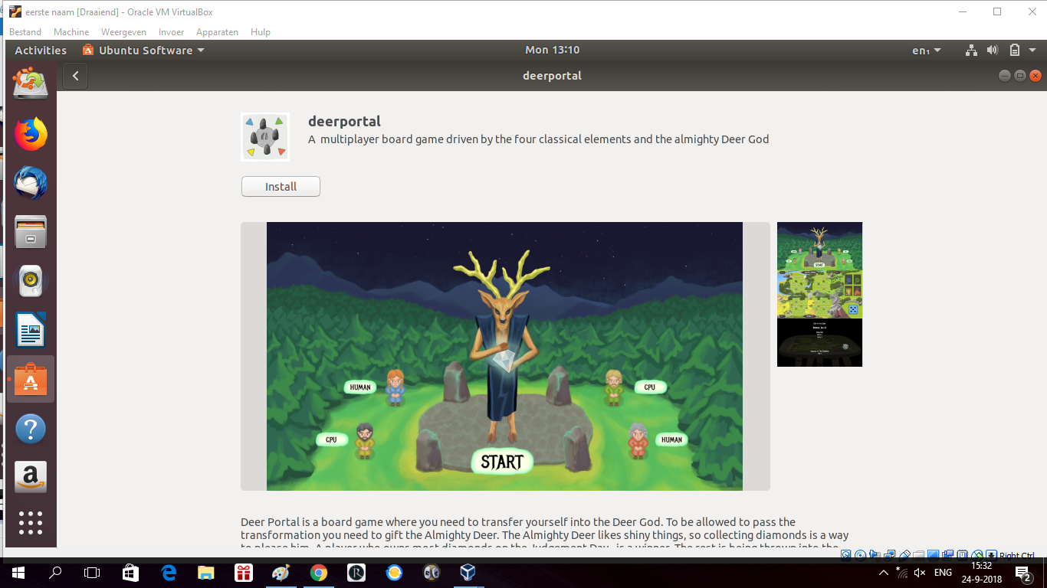
Press install

Slide 6
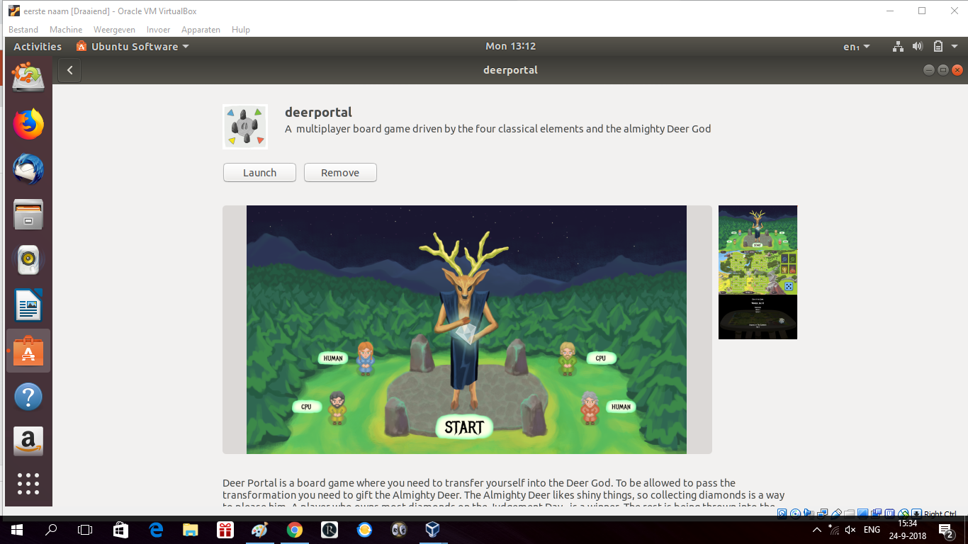
now you are ready to launch

